Slide 1



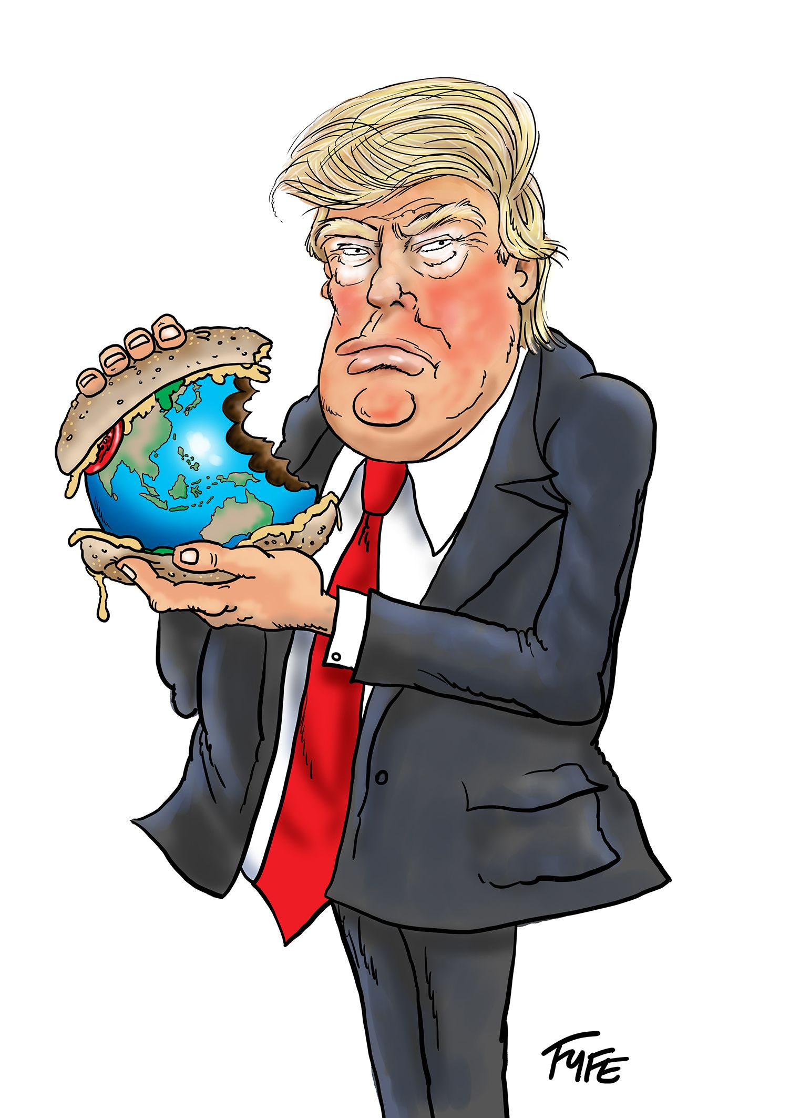
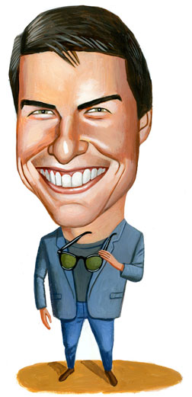

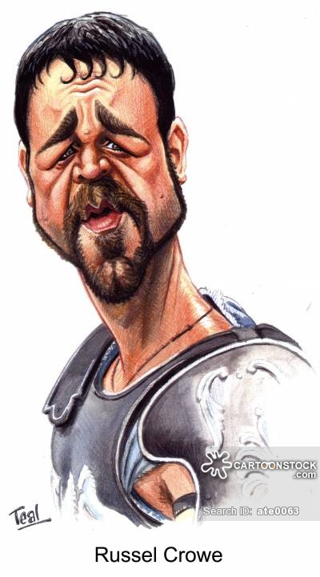

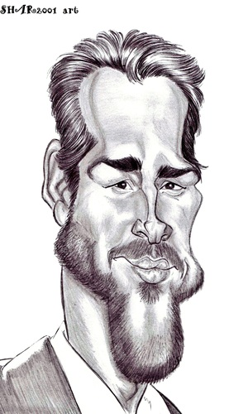
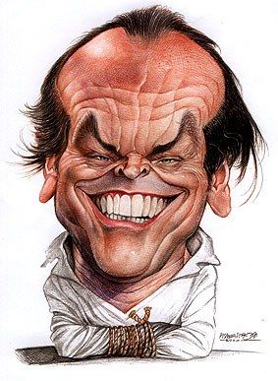
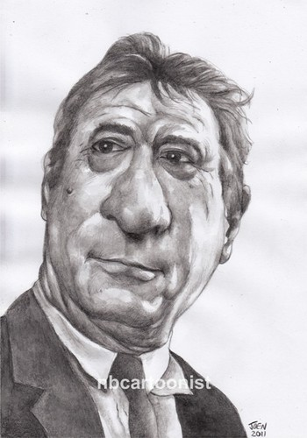
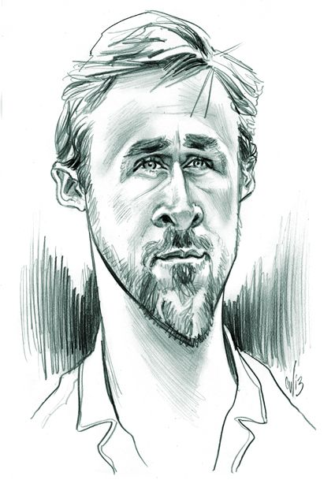
Volleywood

Slide 2

https://www.volleyball.ca/uploads/Development/Referee/Rules/2016_17_Indoor_Rulebook-March2017.pdf

Slide 3
Game Outline
Volleywood is a game created around significant celebrities, who have no idea how to play volleyball for the most part, that have made their mark on Hollywood. Each character will have multiple abilities to chose from in order to help their team. These abilities will be at a cost, and won’t always be successful.
The point of the game is to make your way through different teams of celebrities, through different terrains, in order to win the Volleywood trophy. All proceeds of the winnings would be donated to relevant charities in order to spread awareness.
Don’t be fooled, their will be many options to the game and will be AAA-based, with a production time of roughly 18 months, created for up-to-date consoles.

Slide 4
Example Characters
Homer Simpson
Doug Heffernan
Hugh Heffner
Ronald Mcdonald
Ray Romano
Chris Rock
Will Smith
Jim Carry
Anthony Hopkins
Hugh Jackman
Freddy/Jason
Marvel Universe
DC Universe
Scorpion
Mortal Kombat Alumni
Beyonce
Methodman/Redman
Your Imagination

Slide 5

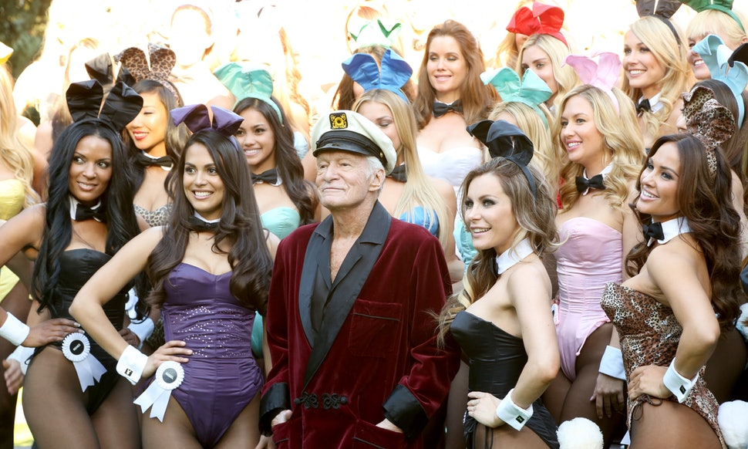
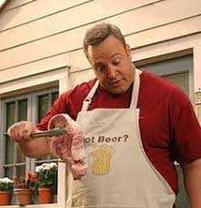
Homer Simpson could power-up into a donut head, catch the ball and spike it anywhere he wants with perfect precision.
The Hef could bring out the bunnies to distract the other team and decrease their precision and power on their shots.
Doug (King of Queens) could rush the net, knocking it over, to collect the last slice of pizza making it certain that your shot is successful.
These are just a few examples of the variety and potential the game has.

Slide 6
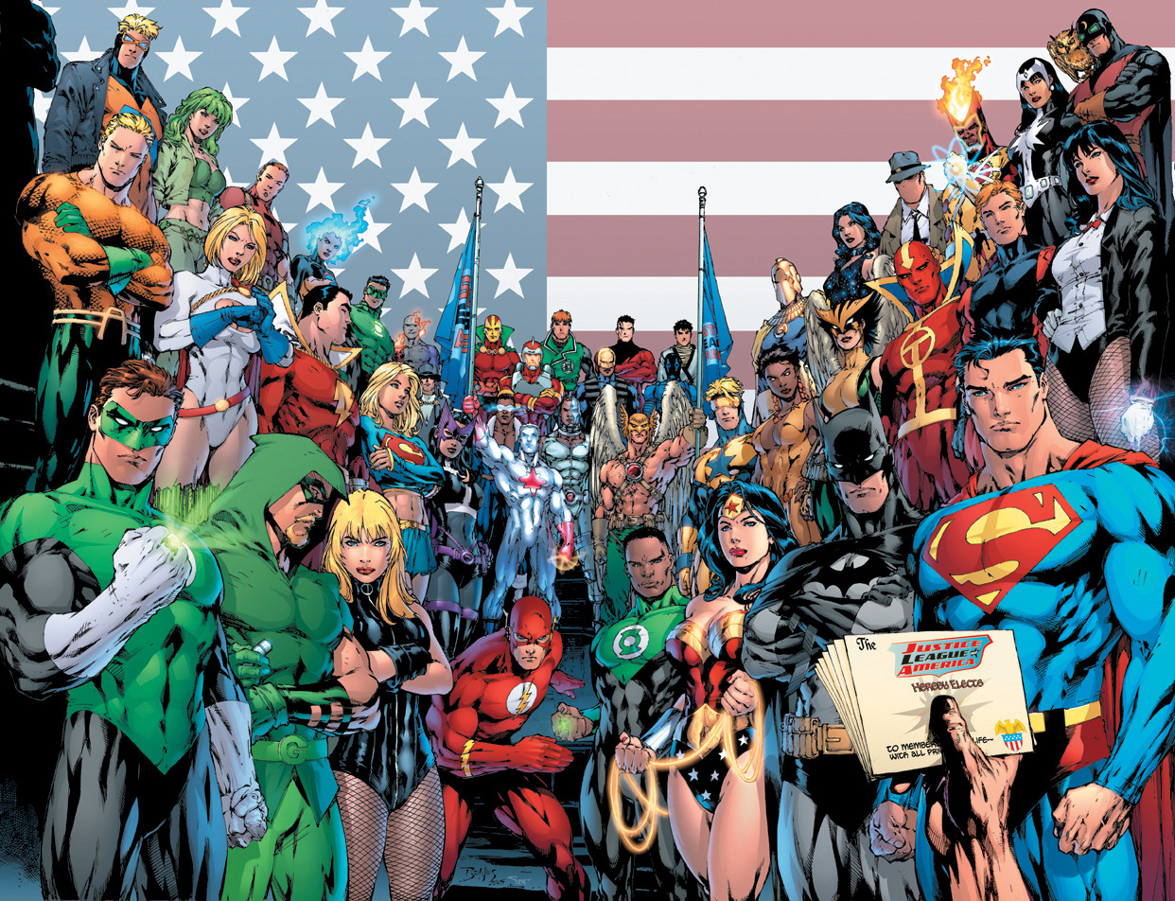

Slide 7
Mechanics
Volleywood, if created would involve numerous mechanics if it had any chance of surviving.
The title screen would involve a number of options.
-Single Player (your choice to pick between 2 to 6 players a side and choose between championship or single event).
-Multiplayer (The same options, where two players on one console can either team up, or battle each other. Of course your only option if battling is single match. A championship can be chosen if both players are on the same team. Also, a final element that I thought appropriate to add to the game is of course the charity you are playing for and creating its awareness . If agreed to by both players and an algorithm is put in place to charge credit cards, you can bet an opponent an agreed sum of money where the loser donates to the winners charity.
-Online (Your favorite group matched up by skill level, or with your choice to approach a greater challenge).
-Training (Training is the fundamentals of the character. Teaching you how to walk/run, jump/dive, and how to use the shot metre (eg. MLB pitching metre). The power-ups will implement a pulse metre, with offensive and defensive abilities, but at a much faster rate. If you do not hit the sweet spot on the metre, your power-up will fail and your character will be incapacitated for a moment of time. You also have to wait for a few moments before attempting another powerup.
-Options (Difficulty, Controller Options (Classic, Option A, B etc..) Blood/Nudity on or off

Slide 8
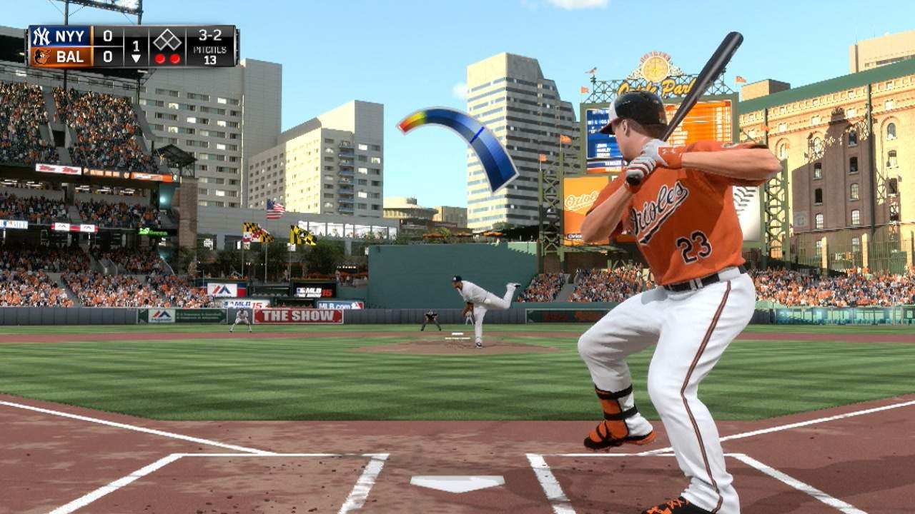
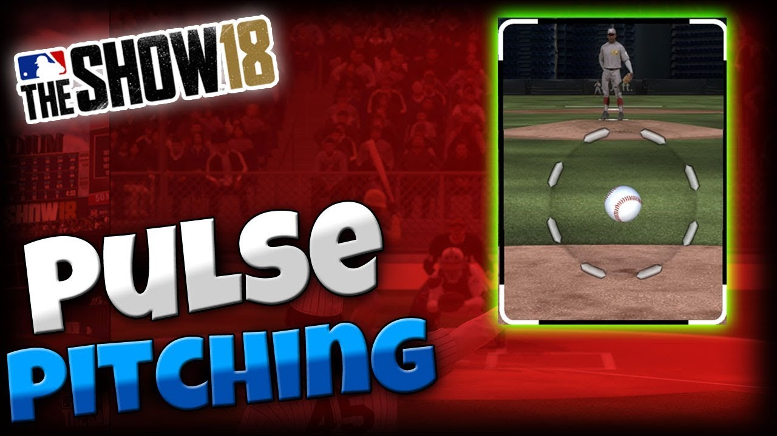
Shot Metre Examples

Slide 9


Slide 10
Continued
Audio- Each characted in Vollewood when scrolled upon will have its own music. Doug for example will be the beginning of the King and Queens show; Scorpion, Mortal Kombat Theme etc…
The game’s audio on the title screen will be neutral. Sportscentre with Jay Onrait and Dan O-Toole in the background making funny gestures on top of the Sportscentre theme.
The music for the levels will be varied on the scenery you choose, but always based on song that’s slightly goofy, but intense also, like Donkey Kong, if the characters are primarily comedians, but intense if the majority of the characters are villains of sort (Mega Man theme).
All characters will have multiple signature quotes to avoid repetition. The sound effects will be what you’d expect, tick at the top of the net, charge up noises as a power move is to be dealt, or simply a slap on the ball. The audio-team would be in charge of the process, of course, along with the final tweaks.
Video- The video will be 3-D, as the game will follow a turn-based pattern, with the addition of action, (violence and nudity), with an artsy touch to increase the unique vision of the game. All characters will be customizable, to a certain extent, (eg. T-shirt, swimsuit, hat, etc…). Although nudity will not be an option for the characters, but if the Nudity/Blood option is on, at parental consent, then the power-ups could potentially involve a titty, or sausage party.

Slide 11
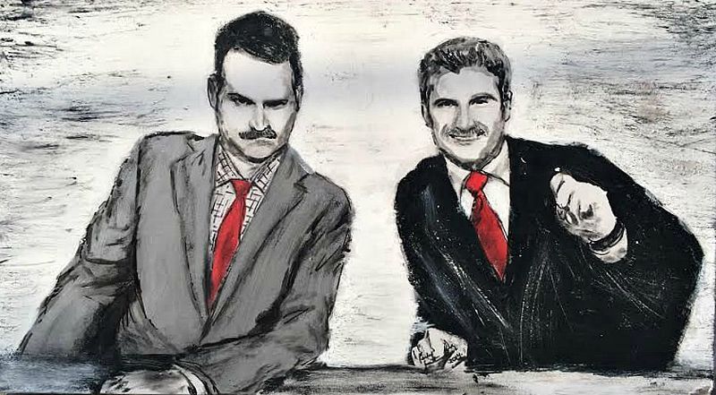

Slide 12

https://www.gamedesigning.org/

Slide 13
Licencing
My idea for licencing would be simple. If you’d like to buy a character (Pamela Anderson for example), you’d have to pay a simple fee towards her favorite charity. In doing so you would have full rights to use her as a player in the game (upgrades, power moves etc.)
The starting characters, however, would be fictional where no licencing would be required.

Slide 14

Congratulations (Record audio and name of your respected charity).

Slide 15


